Slide 1
Statistics for
Business and Economics 8th Edition
Chapter 11
Simple Regression

Slide 2
Chapter Goals
After completing this chapter, you should be able to:
Explain the simple linear regression model
Obtain and interpret the simple linear regression equation for a set of data
Describe R² as a measure of explanatory power of the regression model
Understand the assumptions behind regression analysis
Explain measures of variation and determine whether the independent variable is significant

Slide 3
Chapter Goals
(continued)
After completing this chapter, you should be able to:
Calculate and interpret confidence intervals for the regression coefficients
Use a regression equation for prediction
Form forecast intervals around an estimated Y value for a given X
Use graphical analysis to recognize potential problems in regression analysis
Explain the correlation coefficient and perform a hypothesis test for zero population correlation

Slide 4
Overview of Linear Models
11.1
An equation can be fit to show the best linear relationship between two variables:
Y = β₀ + β₁X
Where Y is the dependent variable and
X is the independent variable
β₀ is the Y-intercept
β₁ is the slope

Slide 5
Least Squares Regression
Estimates for coefficients β₀ and β₁ are found using a Least Squares Regression technique
The least-squares regression line, based on sample data, is
Where b₁ is the slope of the line and b₀ is the y-intercept:

Slide 6
Introduction to Regression Analysis
Regression analysis is used to:
Predict the value of a dependent variable based on the value of at least one independent variable
Explain the impact of changes in an independent variable on the dependent variable
Dependent variable: the variable we wish to explain
(also called the endogenous variable)
Independent variable: the variable used to explain the dependent variable
(also called the exogenous variable)

Slide 7
Linear Regression Model
11.2
The relationship between X and Y is described by a linear function
Changes in Y are assumed to be influenced by changes in X
Linear regression population equation model
Where β₀ and β₁ are the population model coefficients and ε is a random error term.

Slide 8
Simple Linear Regression Model
The population regression model:
Population Slope Coefficient
Random Error term
Population Y intercept
Independent Variable
Dependent Variable
Linear component
Random Error
component

Slide 9
Linear Regression Assumptions
The true relationship form is linear (Y is a linear function of X, plus random error)
The error terms, ε_{i} are independent of the x values
The error terms are random variables with mean 0 and constant variance, σ²
(the uniform variance property is called homoscedasticity)
The random error terms, ε_{i}, are not correlated with one another, so that

Slide 10
Simple Linear Regression Model
(continued)
Y
Observed Value of Y for x_{i}
ε_{i}
Slope = β₁
Predicted Value of Y for x_{i}
Random Error for this X_{i} value
Intercept = β₀
x_{i}
X

Slide 11
Simple Linear Regression Equation
The simple linear regression equation provides an estimate of the population regression line
Estimated (or predicted) y value for observation i
Estimate of the regression intercept
Estimate of the regression slope
Value of x for observation i
The individual random error terms e_{i} have a mean of zero

Slide 12
Least Squares Coefficient Estimators
11.3
b₀ and b₁ are obtained by finding the values of b₀ and b₁ that minimize the sum of the squared residuals (errors), SSE:
Differential calculus is used to obtain the coefficient estimators b₀ and b₁ that minimize SSE

Slide 13
Least Squares Coefficient Estimators
(continued)
The slope coefficient estimator is
And the constant or y-intercept is
The regression line always goes through the mean x, y

Slide 14
Computer Computation of Regression Coefficients
The coefficients b₀ and b₁ , and other regression results in this chapter, will be found using a computer
Hand calculations are tedious
Statistical routines are built into Excel
Other statistical analysis software can be used

Slide 15
Interpretation of the Slope and the Intercept
b₀ is the estimated average value of y when the value of x is zero (if x = 0 is in the range of observed x values)
b₁ is the estimated change in the average value of y as a result of a one-unit change in x

Slide 16

Simple Linear Regression Example
A real estate agent wishes to examine the relationship between the selling price of a home and its size (measured in square feet)
A random sample of 10 houses is selected
Dependent variable (Y) = house price in $1000s
Independent variable (X) = square feet

Slide 17
Sample Data for House Price Model
House Price in $1000s (Y) | Square Feet (X)
245 | 1400
312 | 1600
279 | 1700
308 | 1875
199 | 1100
219 | 1550
405 | 2350
324 | 2450
319 | 1425
255 | 1700

Slide 18
Graphical Presentation
House price model: scatter plot

Slide 19
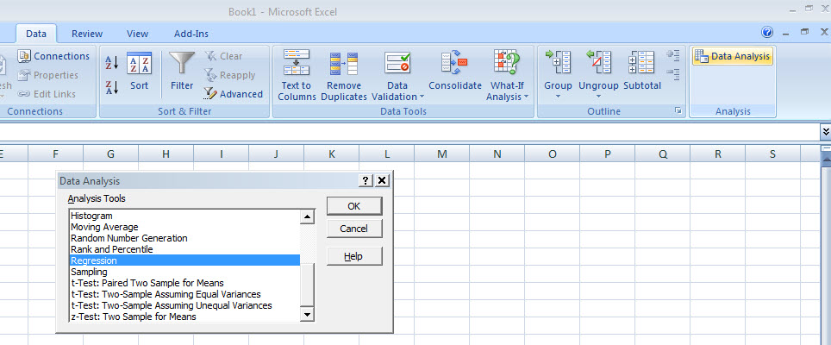
Regression Using Excel
Excel will be used to generate the coefficients and measures of goodness of fit for regression
Data / Data Analysis / Regression

Slide 20
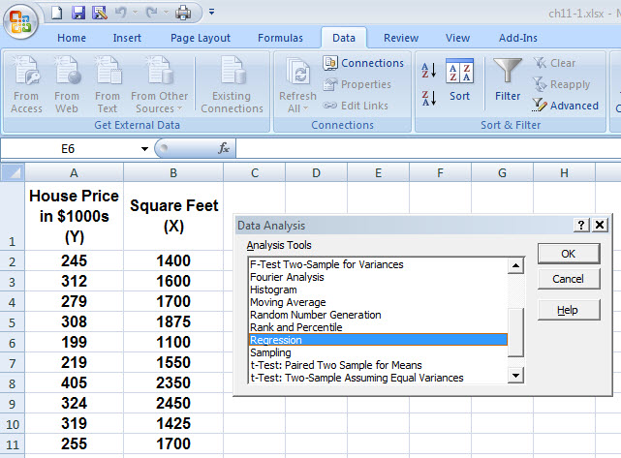
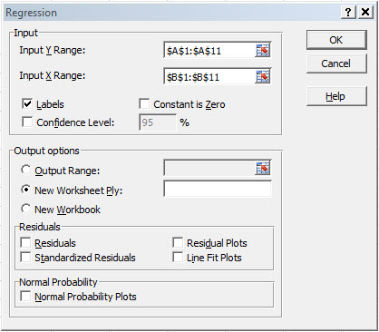
Regression Using Excel
(continued)
Data / Data Analysis / Regression
Provide desired input:

Slide 21
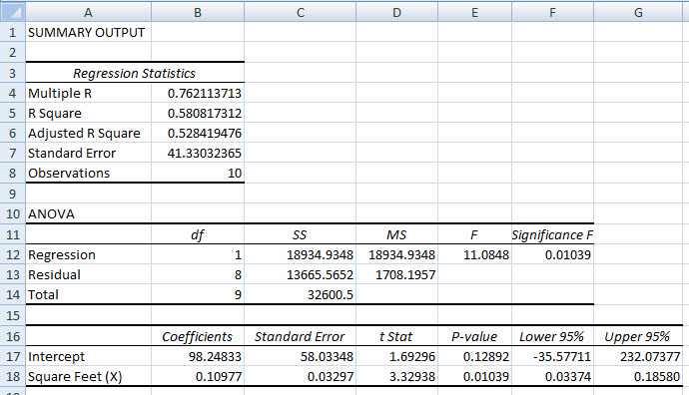
Excel Output

Slide 22
Excel Output
(continued)
Regression Statistics
Multiple R | 0.76211
R Square | 0.58082
Adjusted R Square | 0.52842
Standard Error | 41.33032
Observations | 10
ANOVA | df | SS | MS | F | Significance F
Regression | 1 | 18934.9348 | 18934.9348 | 11.0848 | 0.01039
Residual | 8 | 13665.5652 | 1708.1957
Total | 9 | 32600.5000
 | Coefficients | Standard Error | t Stat | P-value | Lower 95% | Upper 95%
Intercept | 98.24833 | 58.03348 | 1.69296 | 0.12892 | -35.57720 | 232.07386
Square Feet | 0.10977 | 0.03297 | 3.32938 | 0.01039 | 0.03374 | 0.18580
The regression equation is:

Slide 23
Graphical Presentation
House price model: scatter plot and regression line
Slope
= 0.10977
Intercept
= 98.248

Slide 24
Interpretation of the Intercept, b₀
b₀ is the estimated average value of Y when the value of X is zero (if X = 0 is in the range of observed X values)
Here, no houses had 0 square feet, so b₀ = 98.24833 just indicates that, for houses within the range of sizes observed, $98,248.33 is the portion of the house price not explained by square feet

Slide 25
Interpretation of the Slope Coefficient, b₁
b₁ measures the estimated change in the average value of Y as a result of a one-unit change in X
Here, b₁ = .10977 tells us that the average value of a house increases by .10977($1000) = $109.77, on average, for each additional one square foot of size

Slide 26
Explanatory Power of a Linear Regression Equation
11.4
Total variation is made up of two parts:
Total Sum of Squares
Regression Sum of Squares
Error (residual) Sum of Squares
where:
= Average value of the dependent variable
y_{i} = Observed values of the dependent variable
_{i} = Predicted value of y for the given x_{i} value

Slide 27
Analysis of Variance
SST = total sum of squares
Measures the variation of the y_{i} values around their mean, y
SSR = regression sum of squares
Explained variation attributable to the linear relationship between x and y
SSE = error sum of squares
Variation attributable to factors other than the linear relationship between x and y

Slide 28
Analysis of Variance
(continued)
Y
Unexplained variation
y_{i}
∧
∧
y
SSE = ∑(y_{i} - y_{i} )²
_
SST = ∑(y_{i} - y)²
∧
Explained variation
y
_
∧
_
SSR = ∑(y_{i} - y)²
_
y
y
X
x_{i}

Slide 29
Coefficient of Determination, R²
The coefficient of determination is the portion of the total variation in the dependent variable that is explained by variation in the independent variable
The coefficient of determination is also called R-squared and is denoted as R²
note:

Slide 30
Examples of Approximate r² Values
Y
r² = 1
Perfect linear relationship between X and Y:
100% of the variation in Y is explained by variation in X
X
r² = 1
Y
X
r² = 1

Slide 31
Examples of Approximate r² Values
Y
0 < r² < 1
Weaker linear relationships between X and Y:
Some but not all of the variation in Y is explained by variation in X
X
Y
X

Slide 32
Examples of Approximate r² Values
r² = 0
Y
No linear relationship between X and Y:
The value of Y does not depend on X. (None of the variation in Y is explained by variation in X)
X
r² = 0

Slide 33
Excel Output
Regression Statistics
Multiple R | 0.76211
R Square | 0.58082
Adjusted R Square | 0.52842
Standard Error | 41.33032
Observations | 10
ANOVA | df | SS | MS | F | Significance F
Regression | 1 | 18934.9348 | 18934.9348 | 11.0848 | 0.01039
Residual | 8 | 13665.5652 | 1708.1957
Total | 9 | 32600.5000
 | Coefficients | Standard Error | t Stat | P-value | Lower 95% | Upper 95%
Intercept | 98.24833 | 58.03348 | 1.69296 | 0.12892 | -35.57720 | 232.07386
Square Feet | 0.10977 | 0.03297 | 3.32938 | 0.01039 | 0.03374 | 0.18580
58.08% of the variation in house prices is explained by variation in square feet

Slide 34
Correlation and R₂
The coefficient of determination, R², for a simple regression is equal to the simple correlation squared

Slide 35
Estimation of Model Error Variance
An estimator for the variance of the population model error is
Division by n – 2 instead of n – 1 is because the simple regression model uses two estimated parameters, b₀ and b₁, instead of one
is called the standard error of the estimate

Slide 36
Excel Output
Regression Statistics
Multiple R | 0.76211
R Square | 0.58082
Adjusted R Square | 0.52842
Standard Error | 41.33032
Observations | 10
ANOVA | df | SS | MS | F | Significance F
Regression | 1 | 18934.9348 | 18934.9348 | 11.0848 | 0.01039
Residual | 8 | 13665.5652 | 1708.1957
Total | 9 | 32600.5000
 | Coefficients | Standard Error | t Stat | P-value | Lower 95% | Upper 95%
Intercept | 98.24833 | 58.03348 | 1.69296 | 0.12892 | -35.57720 | 232.07386
Square Feet | 0.10977 | 0.03297 | 3.32938 | 0.01039 | 0.03374 | 0.18580

Slide 37
Comparing Standard Errors
s_{e} is a measure of the variation of observed y values from the regression line
Y
Y
X
X
The magnitude of s_{e} should always be judged relative to the size of the y values in the sample data
i.e., s_{e} = $41.33K is moderately small relative to house prices in the $200 - $300K range

Slide 38
Statistical Inference: Hypothesis Tests and Confidence Intervals
11.5
The variance of the regression slope coefficient (b₁) is estimated by
where:
= Estimate of the standard error of the least squares slope
= Standard error of the estimate

Slide 39
Excel Output
Regression Statistics
Multiple R | 0.76211
R Square | 0.58082
Adjusted R Square | 0.52842
Standard Error | 41.33032
Observations | 10
ANOVA | df | SS | MS | F | Significance F
Regression | 1 | 18934.9348 | 18934.9348 | 11.0848 | 0.01039
Residual | 8 | 13665.5652 | 1708.1957
Total | 9 | 32600.5000
 | Coefficients | Standard Error | t Stat | P-value | Lower 95% | Upper 95%
Intercept | 98.24833 | 58.03348 | 1.69296 | 0.12892 | -35.57720 | 232.07386
Square Feet | 0.10977 | 0.03297 | 3.32938 | 0.01039 | 0.03374 | 0.18580

Slide 40
Comparing Standard Errors of the Slope
is a measure of the variation in the slope of regression lines from different possible samples
Y
Y
X
X

Slide 41
Inference about the Slope: t Test
t test for a population slope
Is there a linear relationship between X and Y?
Null and alternative hypotheses
H₀: β₁ = 0 (no linear relationship)
H₁: β₁ ≠ 0 (linear relationship does exist)
Test statistic
where:
b₁ = regression slope
coefficient
β₁ = hypothesized slope
s_{b1} = standard
error of the slope

Slide 42
Inference about the Slope: t Test
(continued)
Estimated Regression Equation:
House Price in $1000s (y) | Square Feet (x)
245 | 1400
312 | 1600
279 | 1700
308 | 1875
199 | 1100
219 | 1550
405 | 2350
324 | 2450
319 | 1425
255 | 1700
The slope of this model is 0.1098
Does square footage of the house significantly affect its sales price?

Slide 43
Inferences about the Slope: t Test Example
b₁
H₀: β₁ = 0
H₁: β₁ ≠ 0
From Excel output:
 | Coefficients | Standard Error | t Stat | P-value
Intercept | 98.24833 | 58.03348 | 1.69296 | 0.12892
Square Feet | 0.10977 | 0.03297 | 3.32938 | 0.01039
t

Slide 44
Inferences about the Slope: t Test Example
(continued)
Test Statistic: t = 3.329
b₁
t
H₀: β₁ = 0
H₁: β₁ ≠ 0
From Excel output:
 | Coefficients | Standard Error | t Stat | P-value
Intercept | 98.24833 | 58.03348 | 1.69296 | 0.12892
Square Feet | 0.10977 | 0.03297 | 3.32938 | 0.01039
d.f. = 10-2 = 8
t_{8,.025} = 2.3060
Decision:
Conclusion:
Reject H₀
α/2=.025
α/2=.025
There is sufficient evidence that square footage affects house price
Reject H₀
Do not reject H₀
Reject H₀
-t_{n-2,α/2}
0
t_{n-2,α/2}
-2.3060
2.3060
3.329

Slide 45
Inferences about the Slope: t Test Example
(continued)
P-value = 0.01039
P-value
H₀: β₁ = 0
H₁: β₁ ≠ 0
From Excel output:
 | Coefficients | Standard Error | t Stat | P-value
Intercept | 98.24833 | 58.03348 | 1.69296 | 0.12892
Square Feet | 0.10977 | 0.03297 | 3.32938 | 0.01039
This is a two-tail test, so the p-value is
P(t > 3.329)+P(t < -3.329) = 0.01039
(for 8 d.f.)
Decision: P-value < α so
Conclusion:
Reject H₀
There is sufficient evidence that square footage affects house price

Slide 46
Confidence Interval Estimate for the Slope
Confidence Interval Estimate of the Slope:
d.f. = n - 2
Excel Printout for House Prices:
 | Coefficients | Standard Error | t Stat | P-value | Lower 95% | Upper 95%
Intercept | 98.24833 | 58.03348 | 1.69296 | 0.12892 | -35.57720 | 232.07386
Square Feet | 0.10977 | 0.03297 | 3.32938 | 0.01039 | 0.03374 | 0.18580
At 95% level of confidence, the confidence interval for the slope is (0.0337, 0.1858)

Slide 47
Confidence Interval Estimate for the Slope
(continued)
 | Coefficients | Standard Error | t Stat | P-value | Lower 95% | Upper 95%
Intercept | 98.24833 | 58.03348 | 1.69296 | 0.12892 | -35.57720 | 232.07386
Square Feet | 0.10977 | 0.03297 | 3.32938 | 0.01039 | 0.03374 | 0.18580
Since the units of the house price variable is $1000s, we are 95% confident that the average impact on sales price is between $33.70 and $185.80 per square foot of house size
This 95% confidence interval does not include 0.
Conclusion: There is a significant relationship between house price and square feet at the .05 level of significance

Slide 48
Hypothesis Test for Population Slope Using the F Distribution
F Test statistic:
where
where F follows an F distribution with k numerator and (n – k - 1) denominator degrees of freedom
(k = the number of independent variables in the regression model)

Slide 49
Hypothesis Test for Population Slope Using the F Distribution
(continued)
An alternate test for the hypothesis that the slope is zero:
Use the F statistic
The decision rule is
reject H₀ if F ≥ F_{1,n-2,α}
H₀: β₁ = 0
H₁: β₁ ≠ 0

Slide 50
Excel Output
Regression Statistics
Multiple R | 0.76211
R Square | 0.58082
Adjusted R Square | 0.52842
Standard Error | 41.33032
Observations | 10
ANOVA | df | SS | MS | F | Significance F
Regression | 1 | 18934.9348 | 18934.9348 | 11.0848 | 0.01039
Residual | 8 | 13665.5652 | 1708.1957
Total | 9 | 32600.5000
 | Coefficients | Standard Error | t Stat | P-value | Lower 95% | Upper 95%
Intercept | 98.24833 | 58.03348 | 1.69296 | 0.12892 | -35.57720 | 232.07386
Square Feet | 0.10977 | 0.03297 | 3.32938 | 0.01039 | 0.03374 | 0.18580
With 1 and 8 degrees of freedom
P-value for the F-Test

Slide 51
F-Test for Significance
(continued)
H₀: β₁ = 0
H₁: β₁ ≠ 0
α = .05
df₁= 1 df₂ = 8
Test Statistic:
Decision:
Conclusion:
Critical Value:
F_{1,8,0.05} = 5.32
Reject H₀ at α = 0.05
α = .05
There is sufficient evidence that house size affects selling price
0
F
Do not
reject H₀
Reject H₀
F_{.05} = 5.32

Slide 52
Prediction
11.6
The regression equation can be used to predict a value for y, given a particular x
For a specified value, x_{n+1} , the predicted value is

Slide 53
Predictions Using Regression Analysis
Predict the price for a house with 2000 square feet:
The predicted price for a house with 2000 square feet is 317.85($1,000s) = $317,850

Slide 54
Relevant Data Range
When using a regression model for prediction, only predict within the relevant range of data
Relevant data range
Risky to try to extrapolate far beyond the range of observed x values

Slide 55
Estimating Mean Values and Predicting Individual Values
Goal: Form intervals around y to express uncertainty about the value of y for a given x_{i}
Confidence Interval for the expected value of y, given x_{i}
Y
∧
y
∧
y = b₀+b₁x_{i}
Prediction Interval for an single observed y, given x_{i}
x_{i}
X

Slide 56
Confidence Interval for the Average Y, Given X
Confidence interval estimate for the
expected value of y given a particular x_{i}
Notice that the formula involves the term
so the size of interval varies according to the distance x_{n+1} is from the mean, x

Slide 57
Prediction Interval for an Individual Y, Given X
Confidence interval estimate for an actual observed value of y given a particular x_{i}
This extra term adds to the interval width to reflect the added uncertainty for an individual case

Slide 58
Example: Confidence Interval for the Average Y, Given X
Confidence Interval Estimate for E(Y_{n+1}|X_{n+1})
Find the 95% confidence interval for the mean price of 2,000 square-foot houses
∧
Predicted Price y_{i} = 317.85 ($1,000s)
The confidence interval endpoints are 280.73 and 354.97, or from $280,730 to $354,970

Slide 59
Example: Prediction Interval for an Individual Y, Given X
∧
Confidence Interval Estimate for y_{n+1}
Find the 95% confidence interval for an individual house with 2,000 square feet
∧
Predicted Price y_{i} = 317.85 ($1,000s)
The confidence interval endpoints are 215.57 and 420.13, or from $215,570 to $420,130

Slide 60
Correlation Analysis
11.7
Correlation analysis is used to measure strength of the association (linear relationship) between two variables
Correlation is only concerned with strength of the relationship
No causal effect is implied with correlation
Correlation was first presented in Chapter 4

Slide 61
Correlation Analysis
The population correlation coefficient is denoted ρ (the Greek letter rho)
The sample correlation coefficient is
where

Slide 62
Test for Zero Population Correlation
To test the null hypothesis of no linear association,
the test statistic follows the Student’s t distribution with (n – 2 ) degrees of freedom:

Slide 63
Decision Rules
Hypothesis Test for Correlation
Lower-tail test:
H₀: ρ ≥ 0
H₁: ρ < 0
Upper-tail test:
H₀: ρ ≤ 0
H₁: ρ > 0
Two-tail test:
H₀: ρ = 0
H₁: ρ ≠ 0
α
α
α/2
α/2
-t_{α}
t_{α}
-t_{α/2}
t_{α/2}
Reject H₀ if t < -t_{n-2, α}
Reject H₀ if t > t_{n-2, α}
Reject H₀ if t < -t_{n-2, α/2}
or t > t_{n-2, α/2}
Where
has n - 2 d.f.

Slide 64
Beta Measure of Financial Risk
11.8
A Beta Coefficient is a measure of how the returns of a particular firm respond to the returns of a broad stock index (such as the S&P 500)
For a specific firm, the Beta Coefficient is the slope coefficient from a regression of the firm’s returns compared to the overall market returns over some specified time period

Slide 65
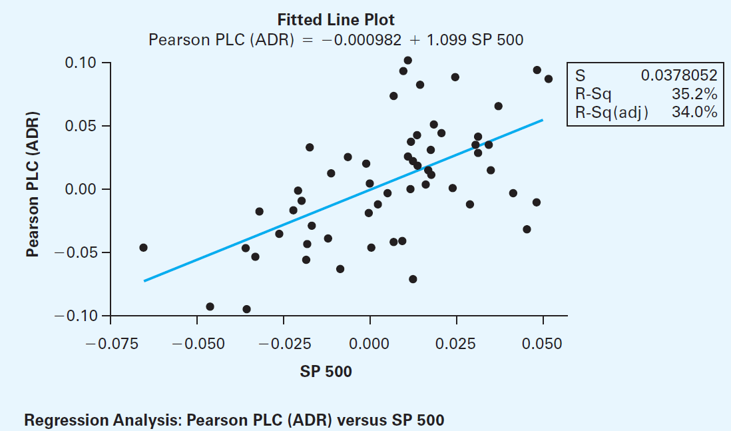
Beta Coefficient Example
Slope coefficient is the Beta Coefficient
Information about the quality of the regression
model that provides the estimate of beta

Slide 66
Graphical Analysis
11.9
The linear regression model is based on minimizing the sum of squared errors
If outliers exist, their potentially large squared errors may have a strong influence on the fitted regression line
Be sure to examine your data graphically for outliers and extreme points
Decide, based on your model and logic, whether the extreme points should remain or be removed

Slide 67
Chapter Summary
Introduced the linear regression model
Reviewed correlation and the assumptions of linear regression
Discussed estimating the simple linear regression coefficients
Described measures of variation
Described inference about the slope
Addressed estimation of mean values and prediction of individual values

Slide 68

All rights reserved. No part of this publication may be reproduced, stored in a retrieval system, or transmitted, in any form or by any means, electronic, mechanical, photocopying, recording, or otherwise, without the prior written permission of the publisher.
Printed in the United States of America.

